Slide 1
Body Fat Percentage Prediction
Carrie Deng, Rachel Studer, Chi Zhang

Slide 2
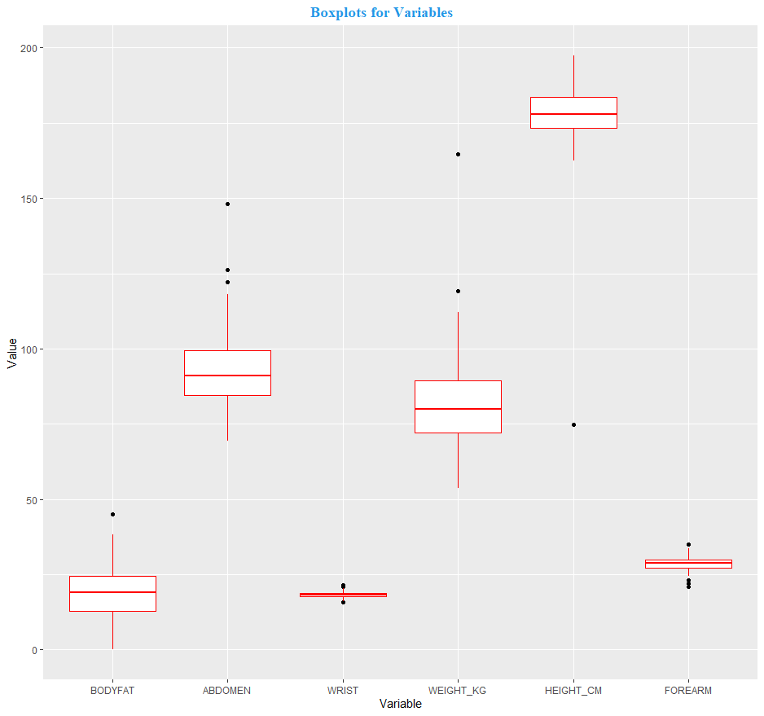
Data Cleaning
3 outliers removed:
Two individuals have fat percentage below 4.0%
No accurate source for new %
One extreme weight and circumferences
Removed for Cook's Distance > 0.5
Variable manipulation:
One height recalculated
Change of imperial -> metric measures

Slide 3
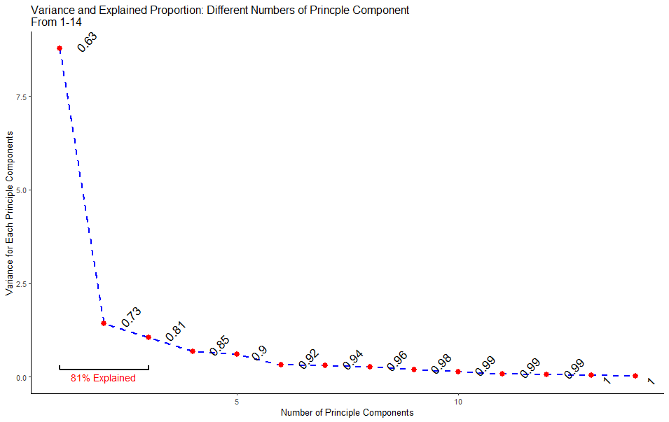
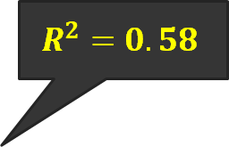
Initial Ideas
Build generalized linear model (GLM)
Gaussian link works best (AIC)
switch to simple linear model
+PCA?
$$R^{2}=0.58$$
Use Linear Model
Much work added, but NO IMPROVEMENT

Slide 4
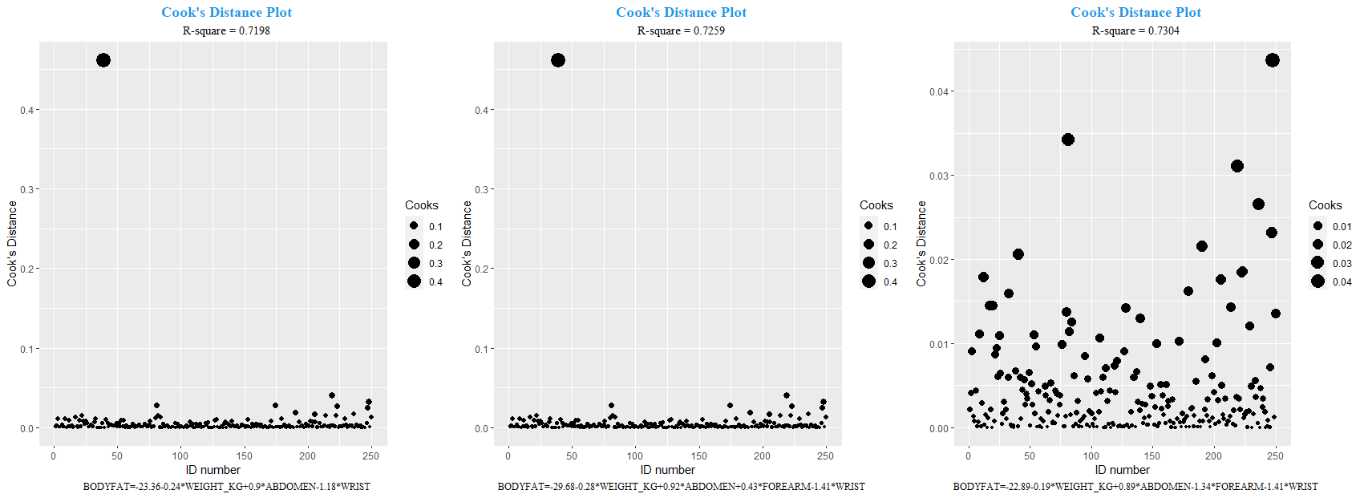
Model Development
Method: Stepwise forward regression
Stopping criteria: change of less than 1% R^2
Comparison Criteria
Linear model assumptions: Normality, Equal Variance, Cook's
Body Fat = Weight + Abdomen + Wrist
(R^2 = 0.7231728)
Body Fat = Weight + Abdomen + Wrist + Forearm
(R^2 = 0.7303030)
Body Fat = Weight + Abdomen + Wrist
(R^2 = 0.7303582)

Slide 5
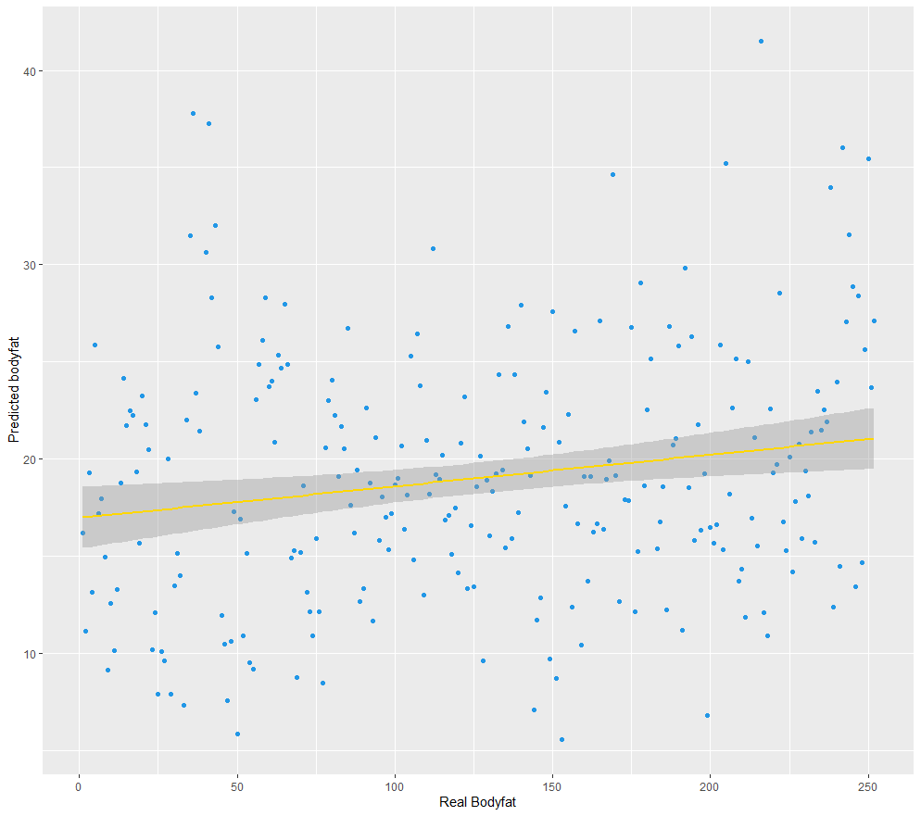
Final Model
𝐵𝑜𝑑𝑦 𝐹𝑎𝑡 % = −22.894 − 0.193𝑊𝑒𝑖𝑔ℎ𝑡(𝑘𝑔)
− 1.336𝑊𝑟𝑖𝑠𝑡 + 0.886𝐴𝑏𝑑𝑜𝑚𝑒𝑛
Multiply 0.9 by abdomen (cm), subtract 0.19 times weight (kg), subtract 1.4 times wrist (cm), & subtract 23.
Ideal Body Builder 5%:
82.5 kg (181lbs)
18.4 cm (7.25 in) wrist
77.2 cm (30 in) abdomen
Weight or Wrist gain could be d/t non-fat gain.
Proportion of fat to weight (or wrist) decreases.
For every 10cm increase in Ab, expect an 8.9% increase in body fat (all else constant)

Slide 6
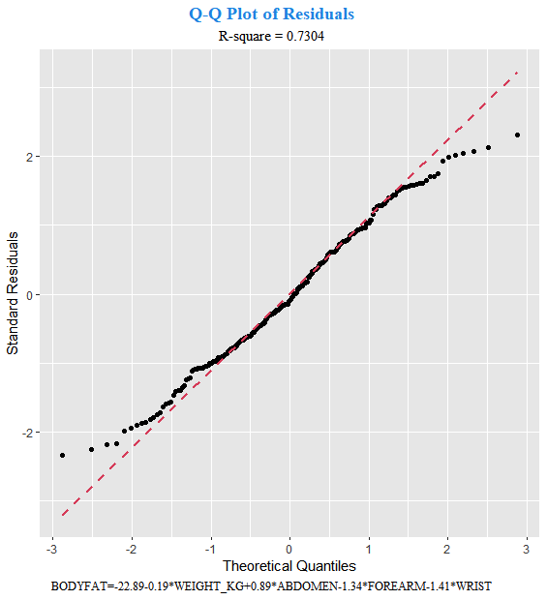
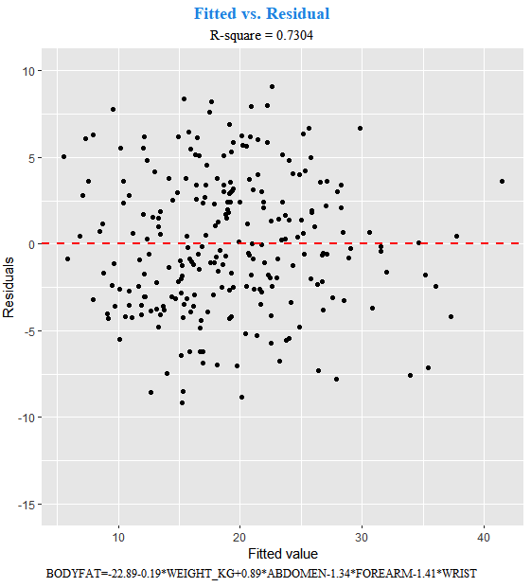
Model Validation
All assumptions met
Normality:
Slightly skewed at both tails
Almost normal
Independence & Constant Variance
“bounce” randomly near 0
Outliers:
Nothing “stands out”

Slide 7


Strengths
Weaknesses
Improvements
Simple and easy to use
Rule of thumb within 1% body fat of model prediction
Straightforward to understand and explain
Can be regularized to avoid overfitting
Precise for average figures only
Issues of small measurements predicting negative %
Collinearity between variables
Increase sample size
Dynamic model

